Slide 1
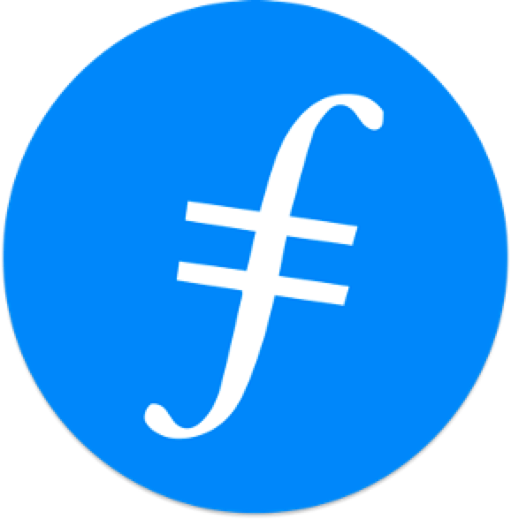



Chapter 7:
Blockchain Infrastructure Landscape: A First Principles Framing
Beginners Guide to Filecoin
Content created by Brown Zhang
Researcher @ KEN Labs

Slide 2
Background
The elements of computing are storage, computing, and communications.
Mainframes, PCs, mobile, and cloud all manifest these elements in their own unique ways.
Specialized building blocks emerge to reconcile tradeoffs within a given element.

Slide 3
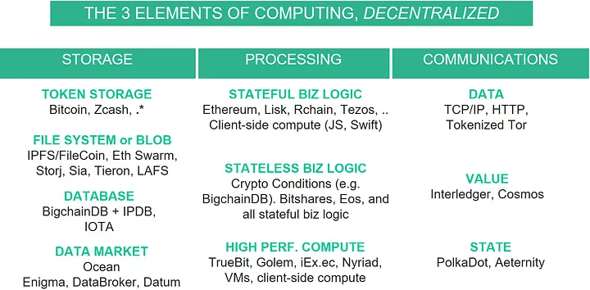
Blockchain Infrastructure Landscape
Blockchain technology is manifesting in each block,
as this image shows:
Storage: token storage, database, file system / blobs
Processing: stateful business logic, stateless business logic, high performance compute
Communications: connect networks of data, of value, and of state

Slide 4
Storage
2
Database: Databases specialize in storing structured metadata
The fundamental computing element of storage has the following building blocks.
3
File system / data blob storage: These are systems to store large files (movies, mp3s, large datasets), organized in a hierarchy of directories and files.
Token storage:Tokens main actions on a token storage system are to issue and transfer tokens (with many variants), while preventing double-spends and the like.
1
Data marketplace:Data marketplaces connect data owners and consumers, facilitating data trading and sharing, with examples like Ocean, Enigma Catalyst, Datum, and DataBroker DAO.
4

Slide 5
Processing
1
Stateless (combinational) business logic: they don’t have state, it’s easy to verify large stateless smart contracts, and therefore to build large verified / secure systems. N inputs and one output requires O(2^N) computations to verify.
"Smart contracts" systems encompass two subsets, stateless and stateful, which offer different properties in terms of complexity and verifiability, while high-performance compute (HPC) serves as an additional decentralized processing building block.
Stateful (sequential) business logic: stateful business logic is a Turing machine that takes in a sequence of inputs, and returns a sequence of outputs. Systems that manifest (a practical approximation of) this are called Turing-complete systems
2
High-Performance Compute (HPC):This is processing to do “heavy lifting” compute for things like rendering, machine learning, circuit simulation, weather forecasting, protein folding, and more.
3

Slide 6
Communications
1
Data:Cerf and Kahn invented TCP/IP in the 70s to connect them, to create a network of networks, which we now call the internet. TCP/IP is now the de-facto standard to connect networks.
There are many ways to frame communications; I will focus on connecting networks. It comes in three levels: data, value, and state.
Value:Interledger Protocol(ILP) is the same conceptual idea as two-way pegs (think sidechains) and state channels (think Lightning & Raiden); but the focus is 100% on connecting networks with respect to value.
2
State: a smart contract in Ethereum mainnet that can move its state to another Ethereum net, or another compatible net.
3

Slide 7
Examples
Here are a couple leading edge examples:
Ujo uses IPFS|Swarm + IPDB + Ethereum for decentralized music, just as envisioned here.
Innogy uses IPFS + IPDB + IOTA for supply chain / IoT applications.

Slide 8
Related Work
Joel Monegro’s “Fat Protocols” framing emphasizes each building block as a protocol.
Fred Ehrsam’s “Dapp Developer Stack” has an emphasis on web business models.
The BigchainDB whitepaper (first released Feb 2016) Figure 1 gave an earlier version of the stack of this post.
Stephan Tual’s “Web 3.0 Revisited” stack is spiritually similar to this post, though with a bigger focus on Ethereum.
Alexander Ruppert’s “Mapping the decentralized world” has about 20 groupings of organizations, with the x-axis giving four higher-level groupings from infrastructure layer to application layer, but with middleware and liquidity as intermediate levels.

Slide 9
Future
Systems like Ujo combine many blocks together and leverage the benefits of all of these systems.
This trend will accelerate as folks get a better understanding of how the building blocks relate. It’s also more productive than framing everything into one monolith called “blockchain”.

Slide 10
Conclusion
There’s no one magic system called “blockchain” that magically does everything. Rather, there are really good building blocks of computing that can be used together to create effective decentralized applications.

Slide 11

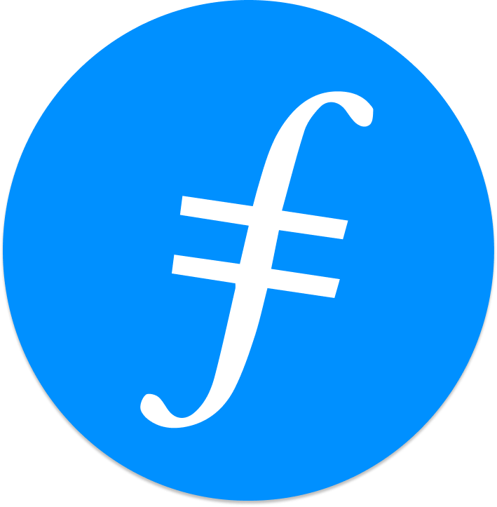
Feedback is welcomed.
https://github.com/kenlabs/Beginners-Guide-to-Filecoin

